Slide 1

PROFIT MARGIN FORECASTING
Spring 2023 MGMT672 – Merge Sec3
Advanced Business Analytics
Group Name: Sec3Team 1

Slide 2







MEET THE team – DATA EMPORIUM CONSULTANCY
Anusha Reddy
Deepa Narayanan
Dustin Allred
Jai Trivedi
Prashanth Suresh
Yu Ning, Chen

Slide 3
EXECUTIVE SUMMARY
Objective
Identifying potential profit-making regions and categories for market expansion.
Analysis
Forecast profit margin for the next six months for each product category across different regions.
Method
Employ ARIMA model for forecasting and use metrics like MAE, RMSE, AIC for model evaluation.
Reason
Accurate forecasts are needed to ensure efficient investments and growth strategies.
Implementation Workflow
Exploratory Analysis
Create Data Plan
Aggregate data at month level and filter for non-returnable orders
Pick Forecasting Technique
Predict The Data
Recommendations And Next Steps
Identify unprofitable/profitable regions and drill down by category and sub-category
Forecast sales and profits across regions and categories
Descriptive analysis to identify distribution of sales and profit across regions and categories
Evaluate models and select the one with highest accuracy

Slide 4
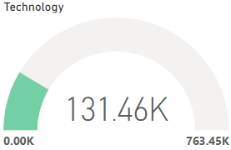
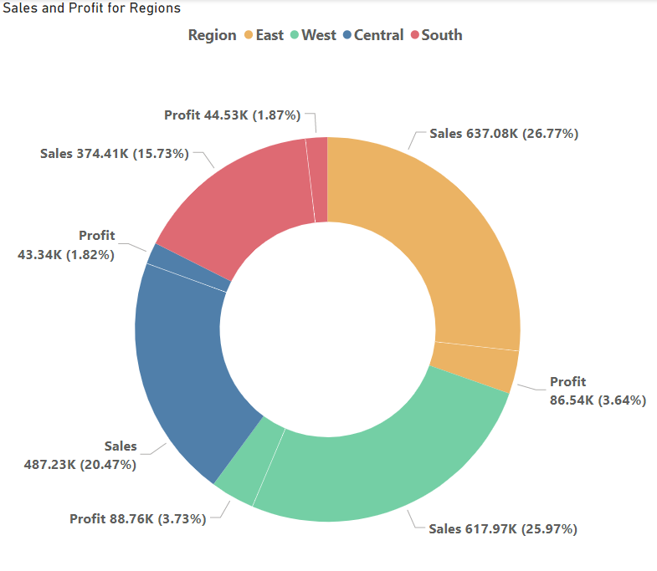
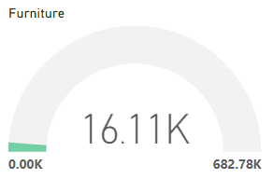
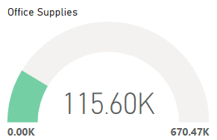
Descriptive analysis- SALES & PROFITS
Sales
Profits
West and East regions account to 65% of total profit and 60% of total sales
Technology has the highest sales of 760K with 131K profit

Slide 5
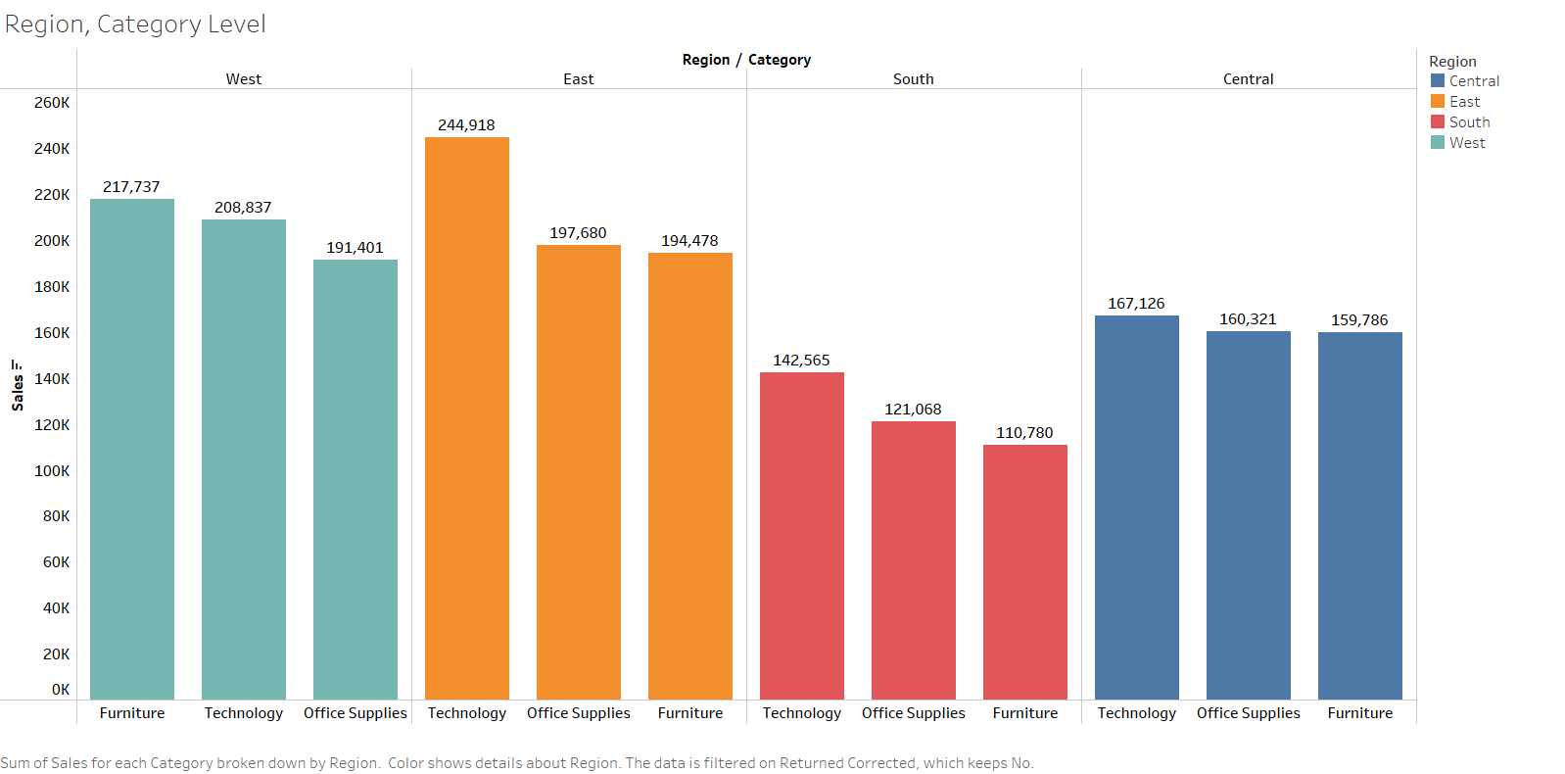
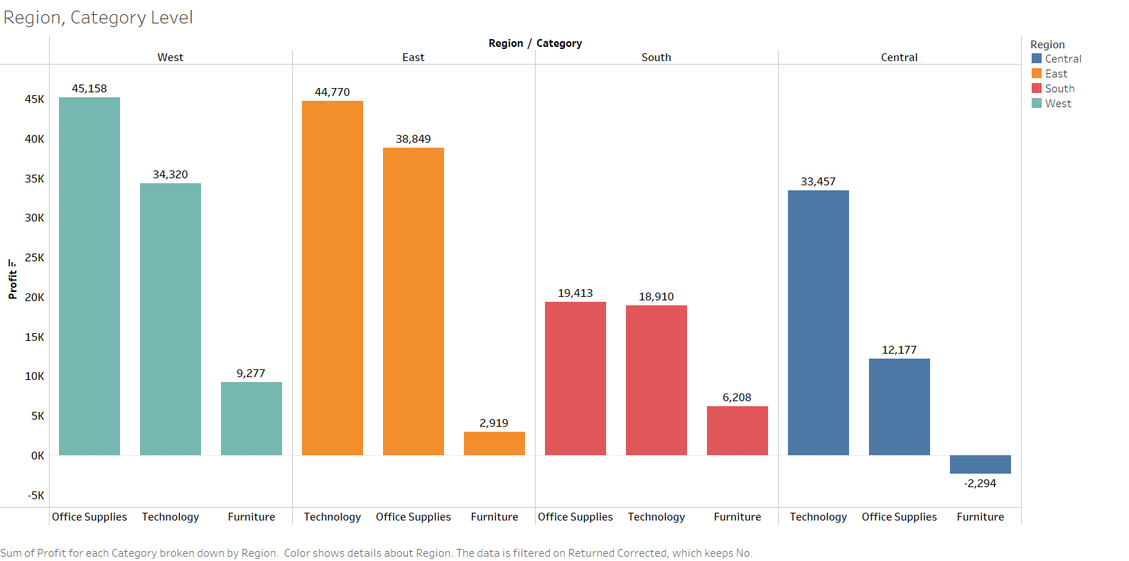
Descriptive analysis- SALES & PROFITS
Sales Distribution
Profit Distribution
Technology has highest profit and sales in the East and Central regions among all other categories
Furniture sees negative profits in the Central region even though it has comparable sales to other products. It has the highest sales in West Region
In West region, Office Supplies have the lowest sales but sees the highest profits

Slide 6




Modeling process
Identify Trend & Seasonality
- Check for time series components i.e. trends/level/seasonality
Create Models
Tailor models to capture the components by region and category
Evaluate Model Performance
Use cross-validation and AIC scores for model selection
Generate Forecasts
Based on the above assessment we predict the category and region wise sales and profits for the next 6 months
Sample Model Evaluation for Furniture Sales

Slide 7

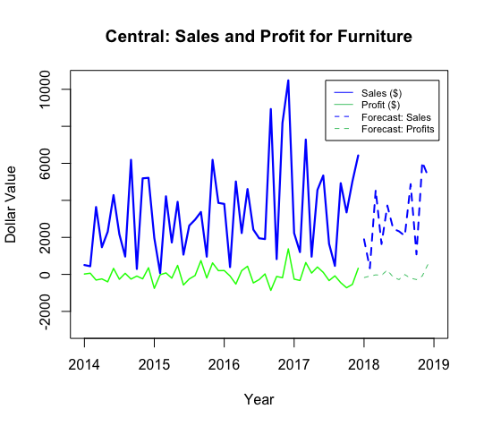
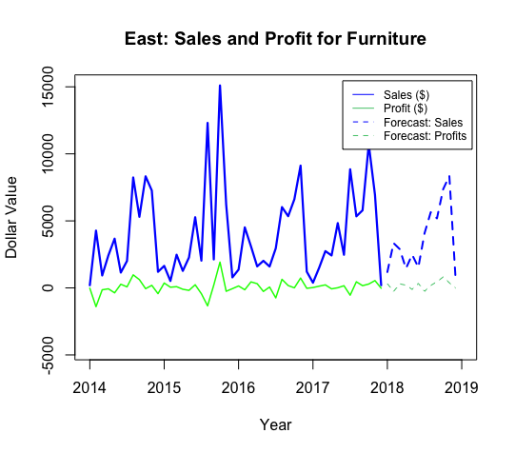
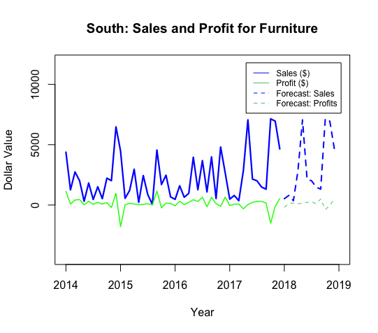
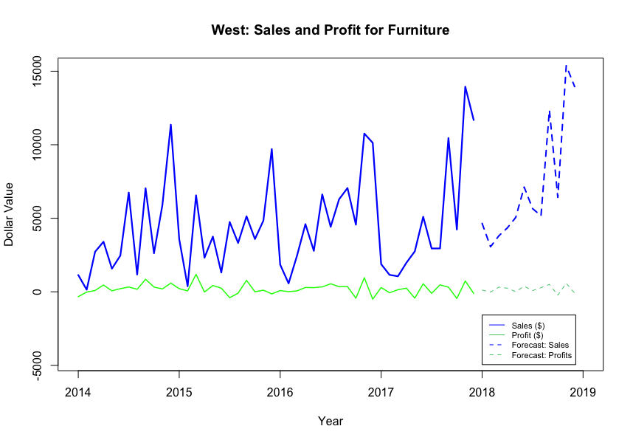
Furniture: Sales and Profit Forecasts
Central
East
Forecasted Average Sales and Profits:
Next 6 Months
 | Central | East | South | West
Sales | $ 2,435 | $ 2,146 | $ 2,287 | $ 4,675
Profits | - $ 42 | $ 130 | $ 91 | $ 176
Profit Margin | - 2% | 6% | 4% | 4%
South
West

Slide 8
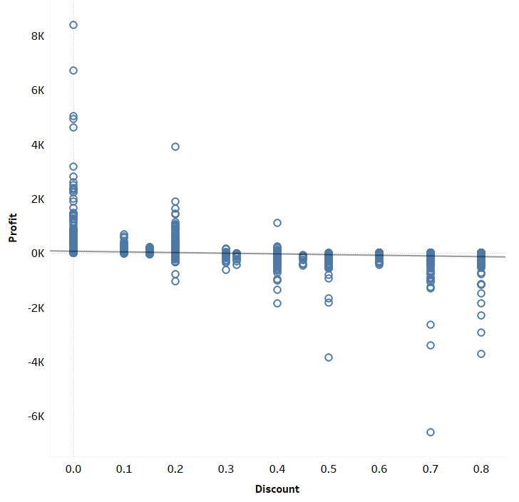
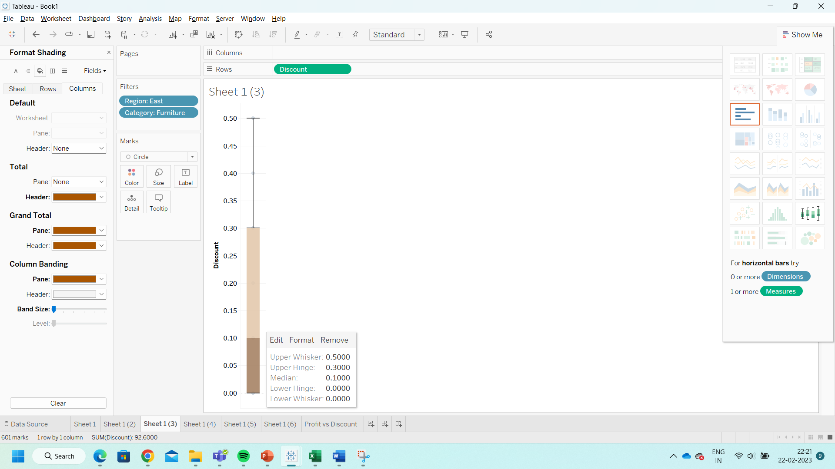
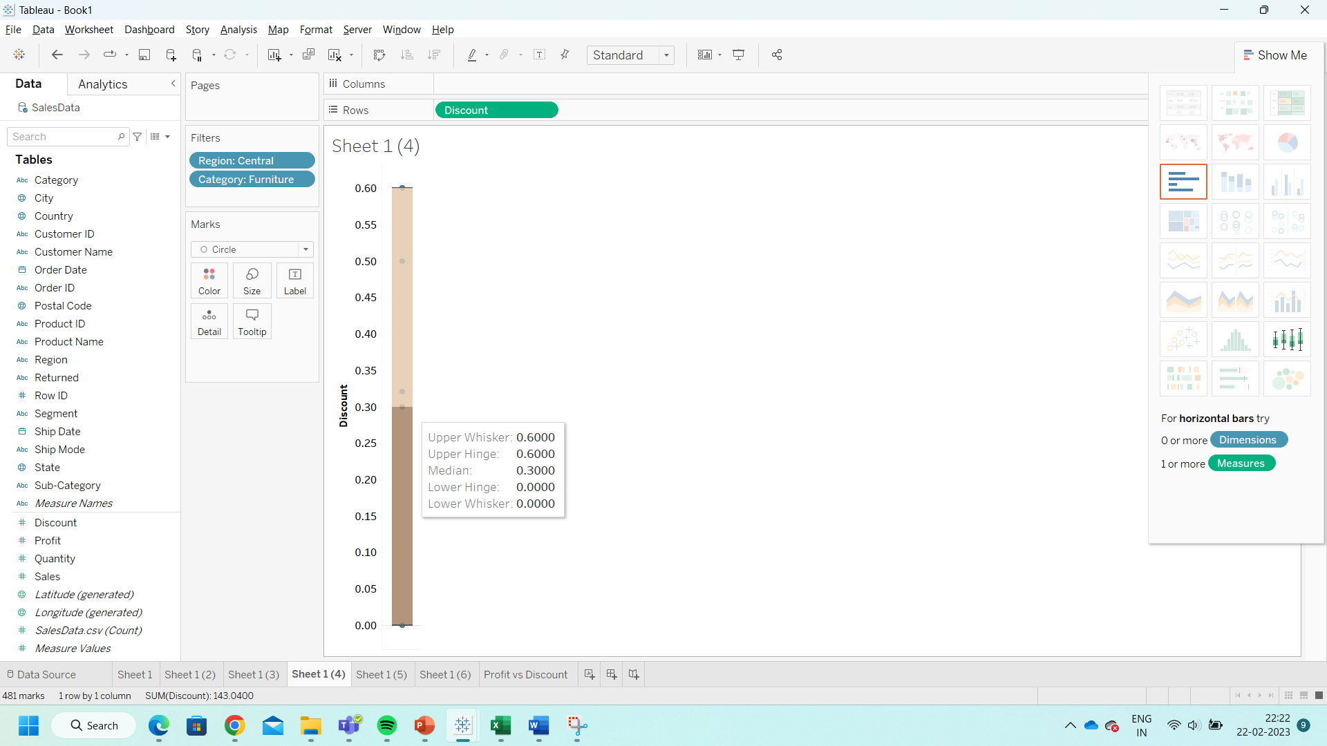
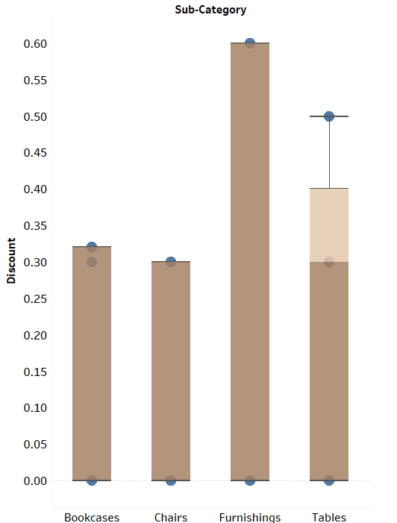
INFLUENTIAL FACTORS- DISCOUNTS
PROFIT VS DISCOUNT
EAST
CENTRAL
High discounts offered in the Central region can potentially be the a reason for a negative profit margin
Furnishings in particular have the highest discounts offered among all other Furniture products

Slide 9

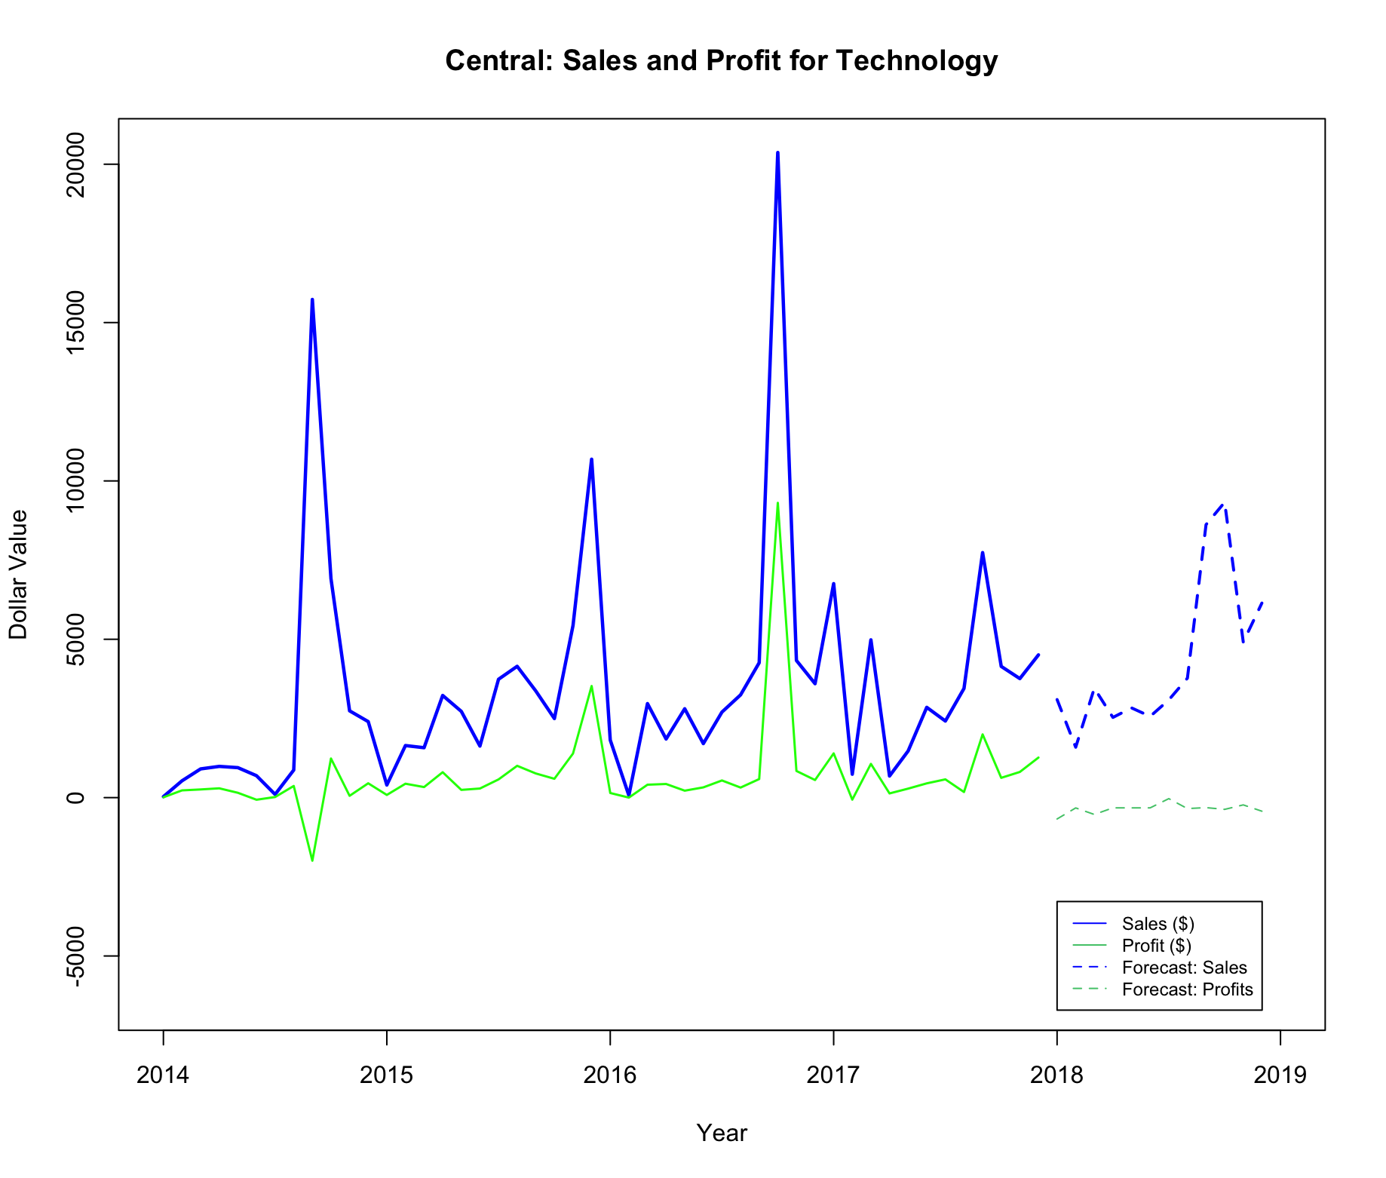
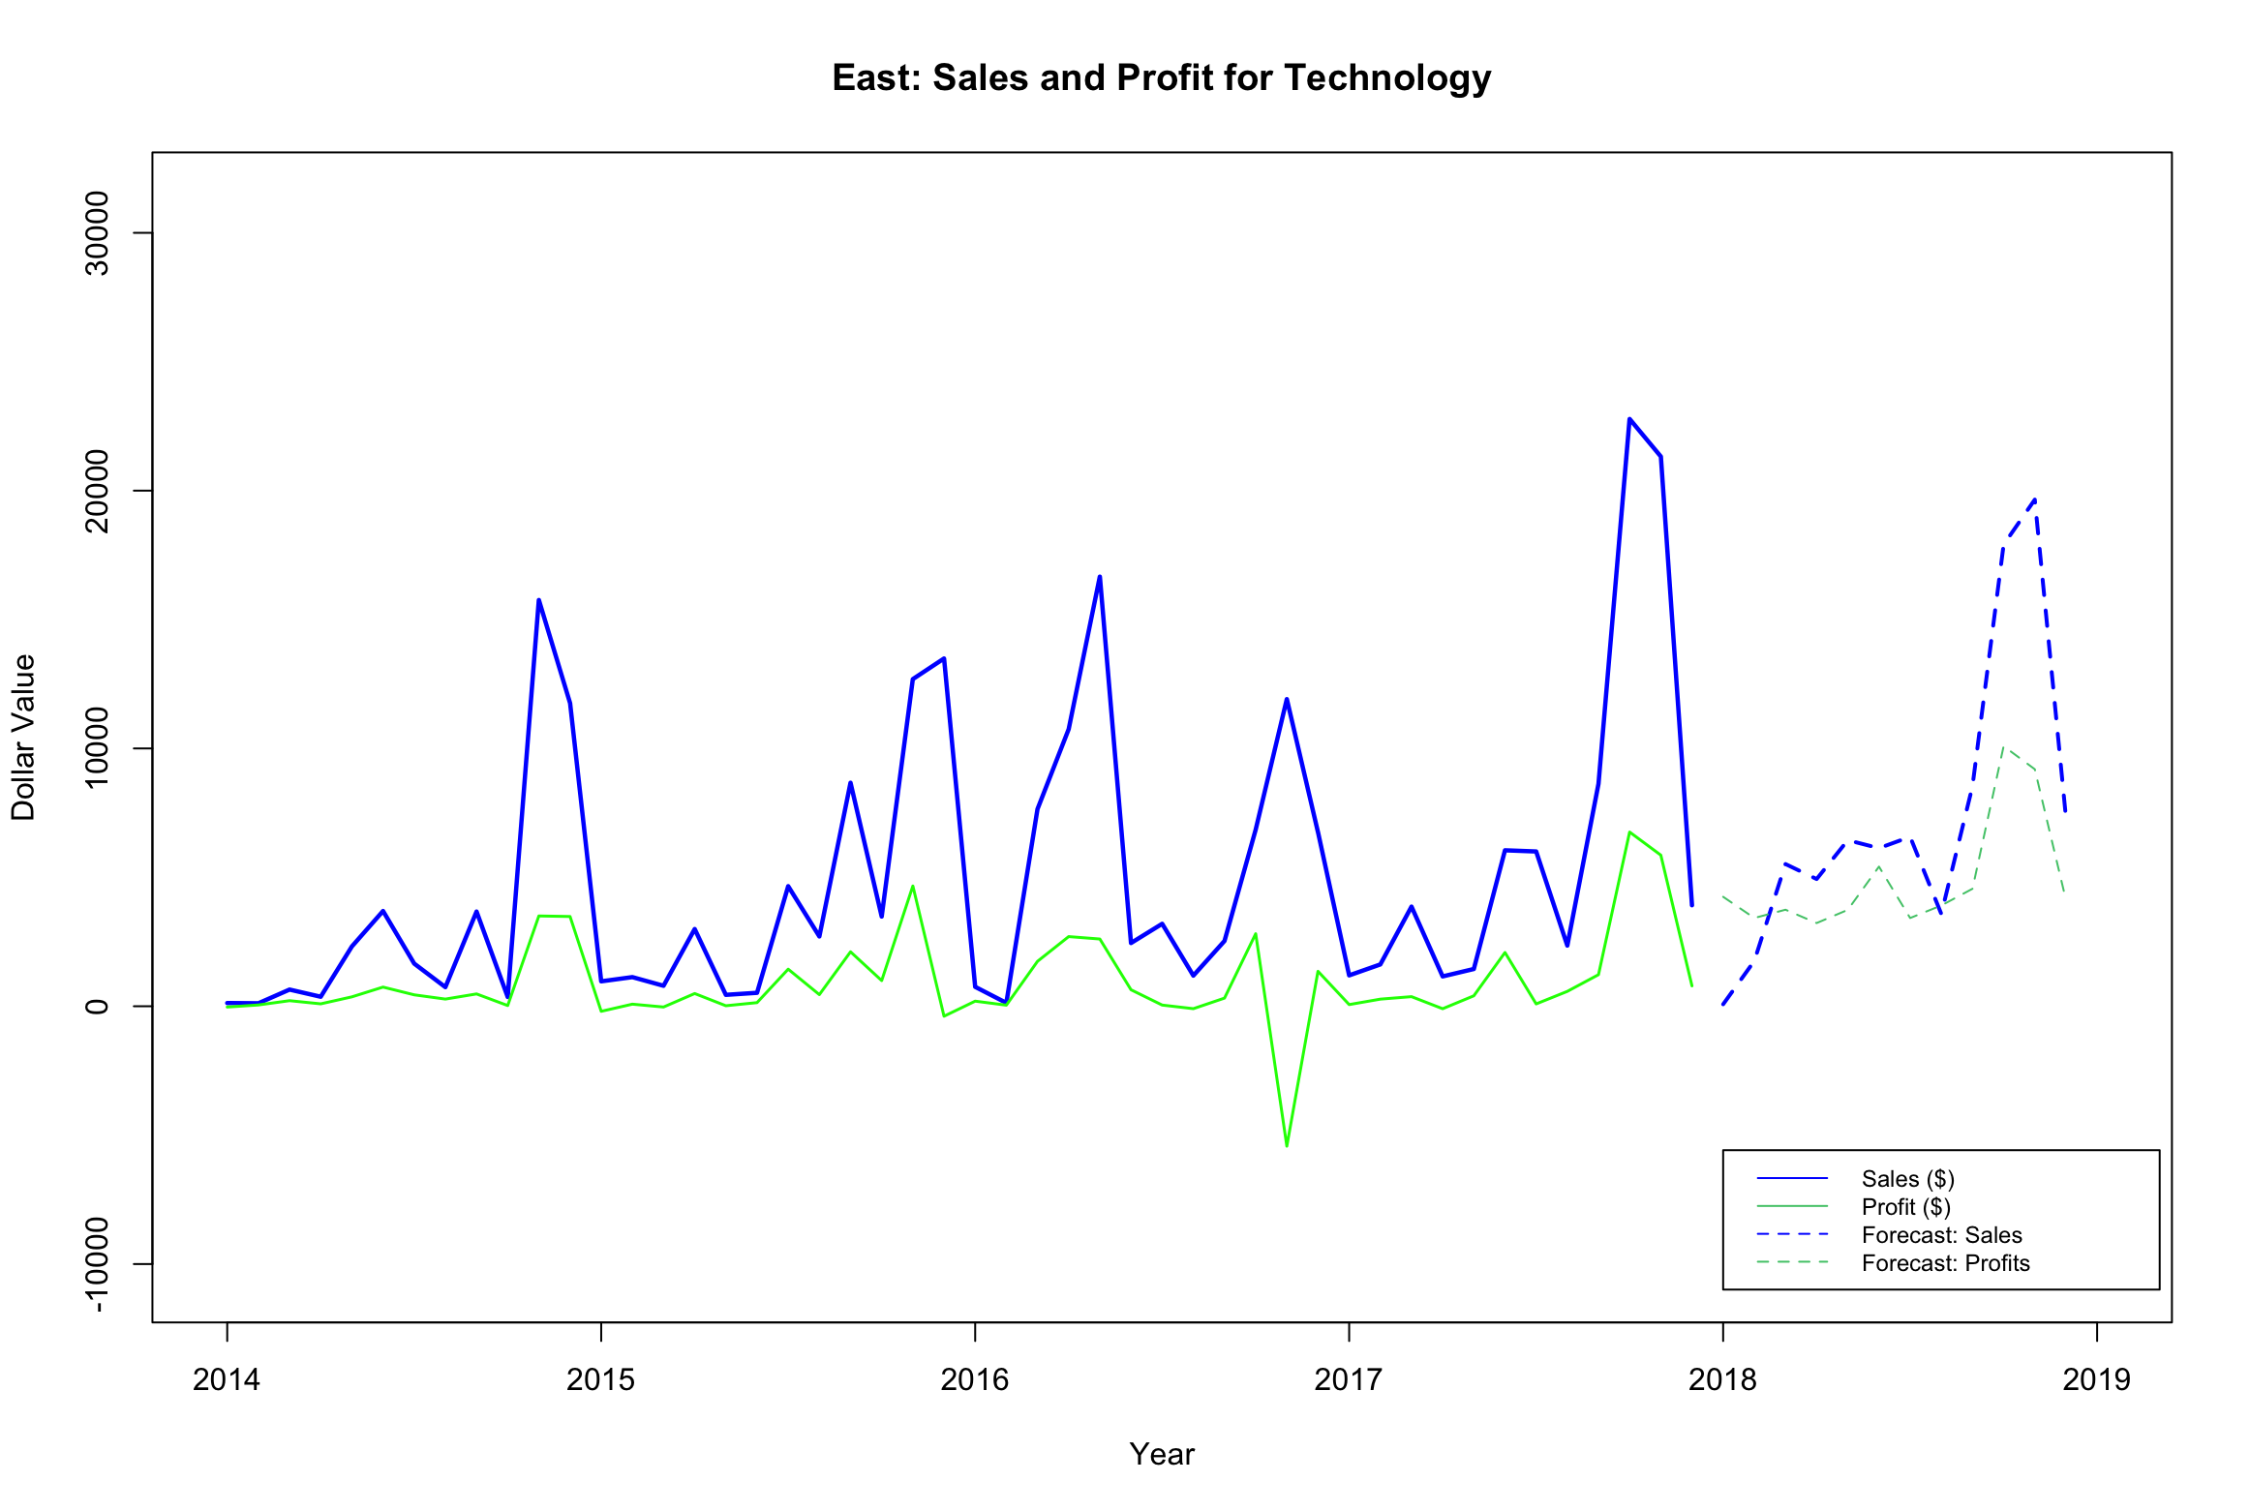
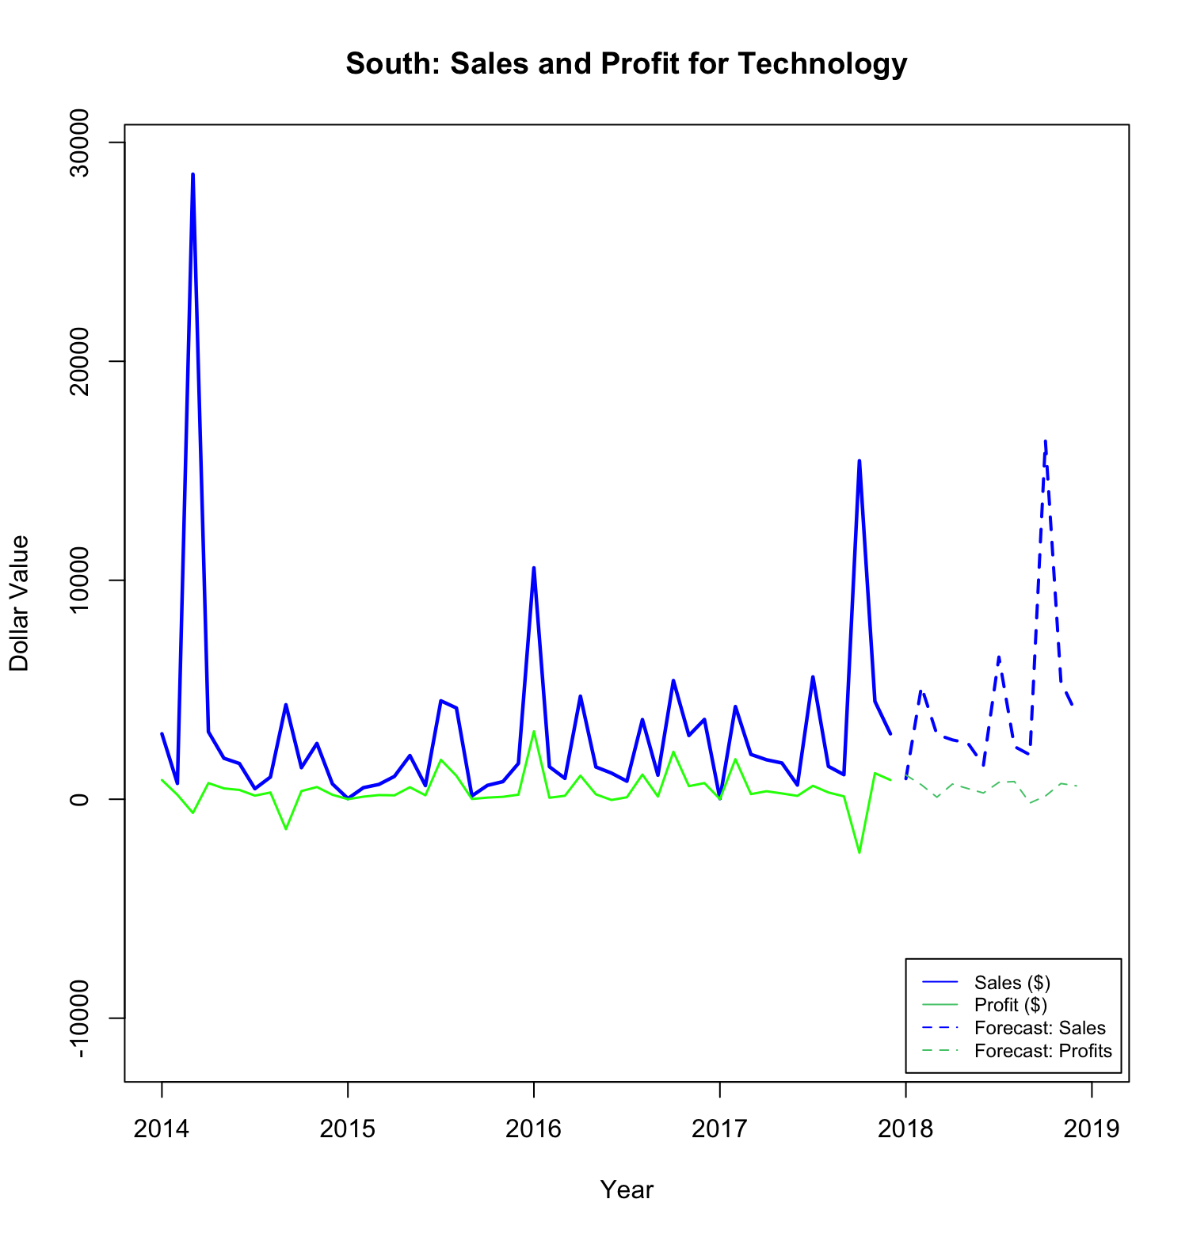
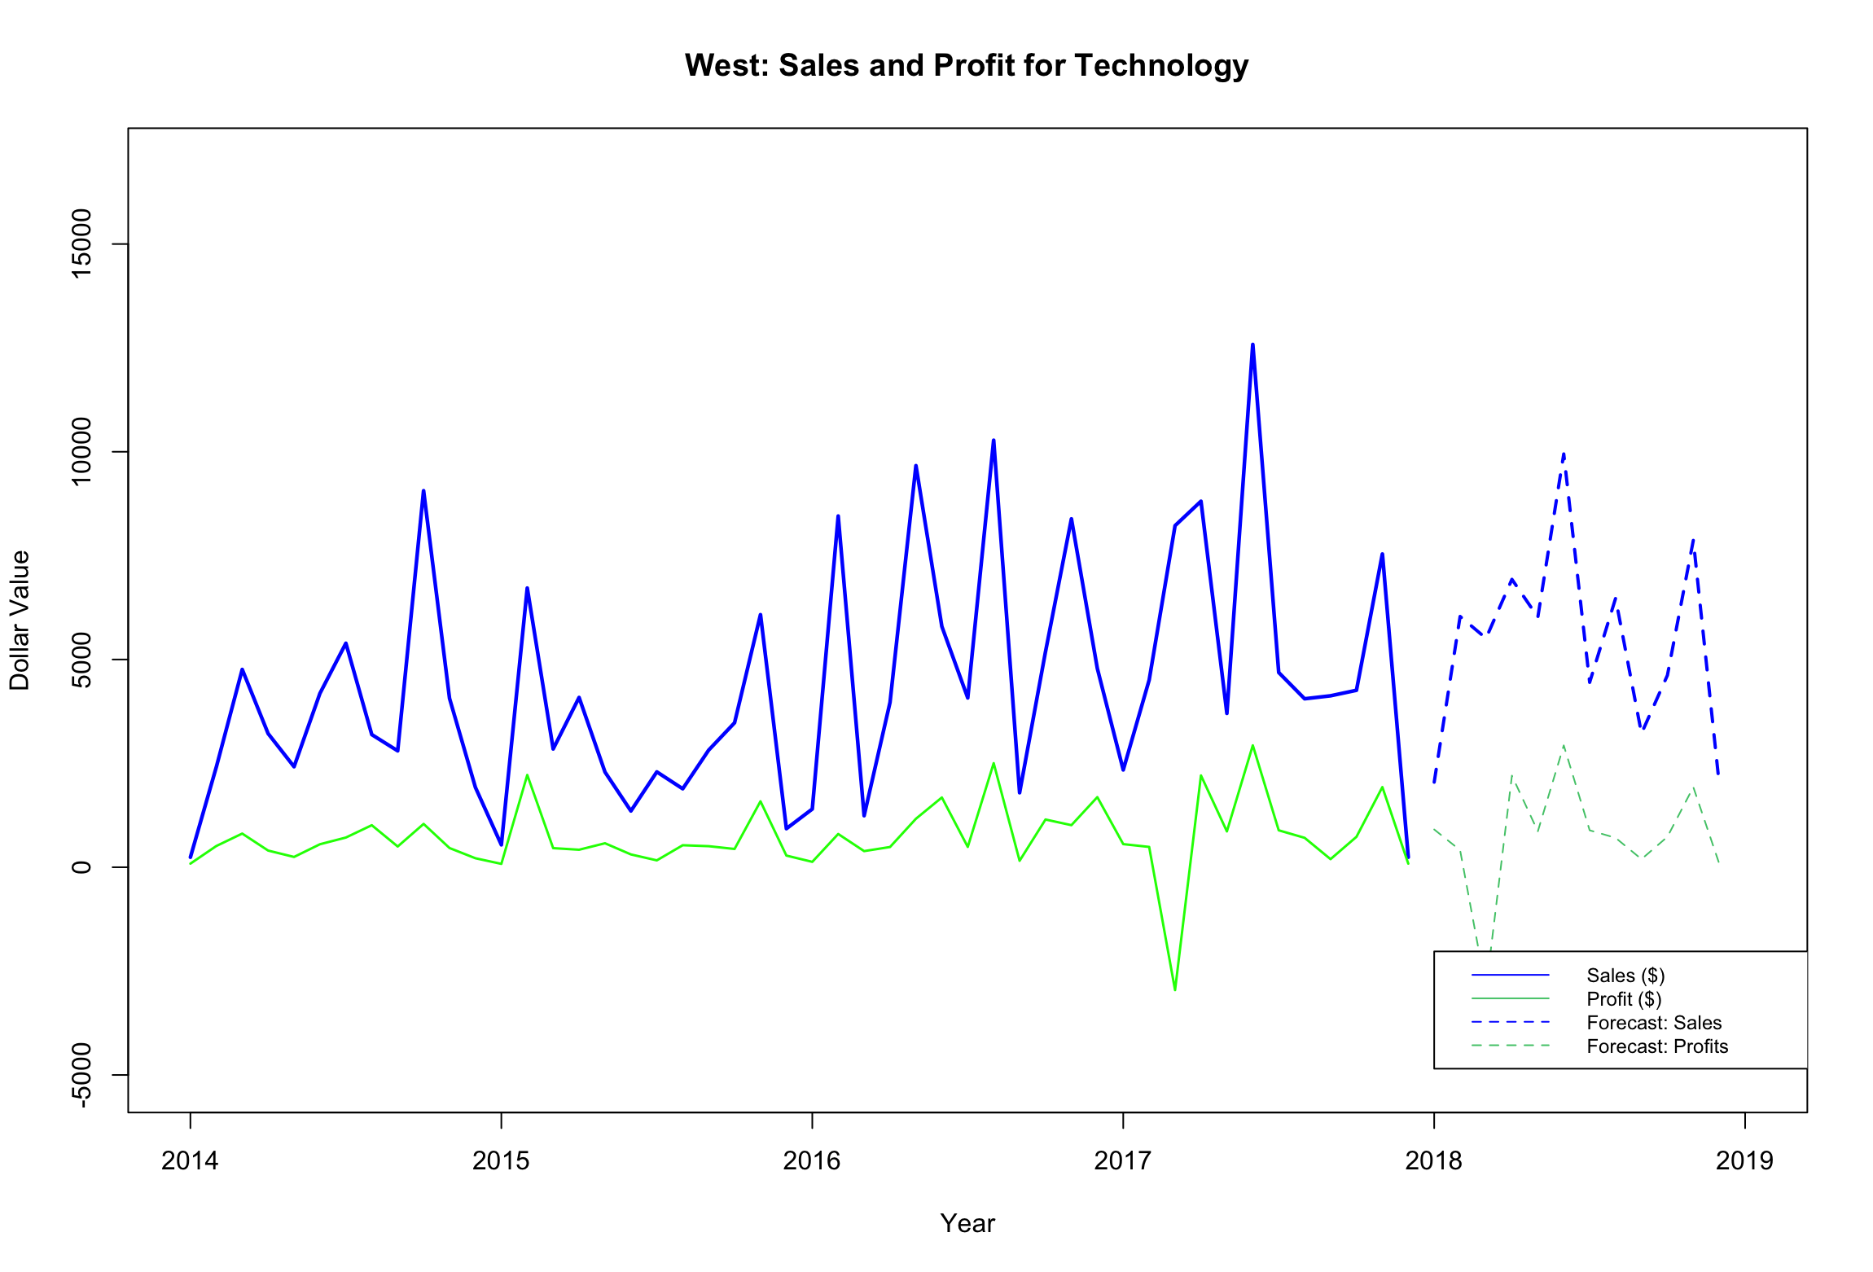
Technology: Sales and Profit Forecasts
Central
East
Forecasted Average Sales and Profits:
Next 6 Months
 | Central | East | South | West
Sales | $ 2,679 | $ 4,143 | $ 2,642 | $ 6,081
Profits | $ 817 | $ 3,966 | $ 553 | $ 730
Profit Margin | 30% | 95% | 20% | 12%
South
West

Slide 10
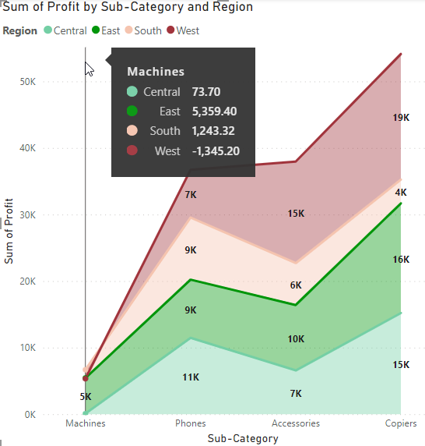
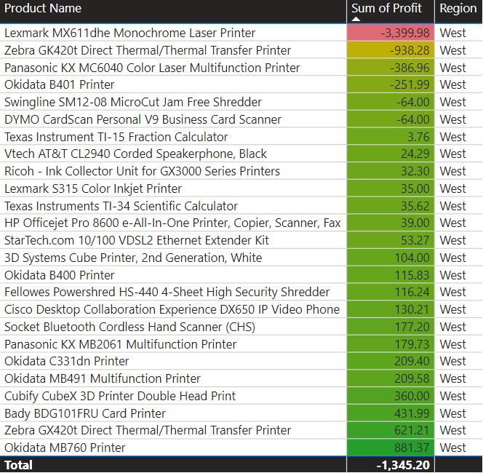
INFLUENTIAL FACTORS – SUB CATEGORY DEMAND
Sales of Machine sub-category is profitable in East region and loss making in West
Lexmark MX611dhe Laser Printer has a significant impact on loss for Machines sold in West Region

Slide 11

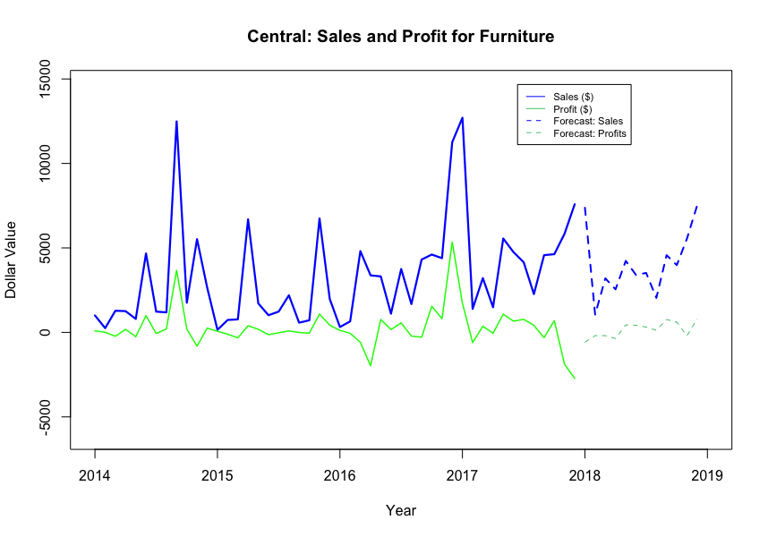
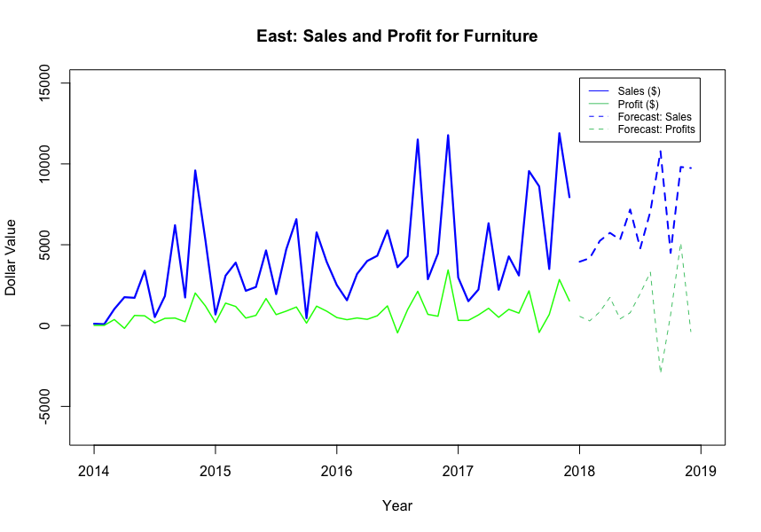
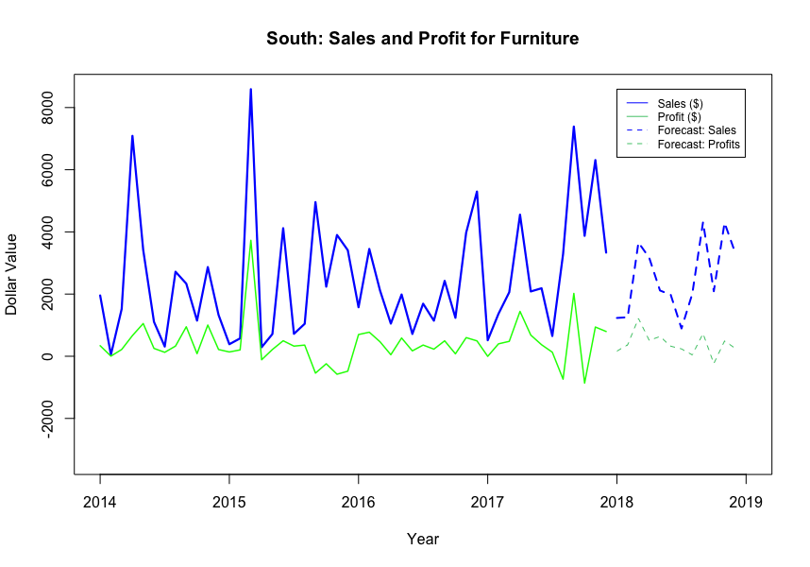
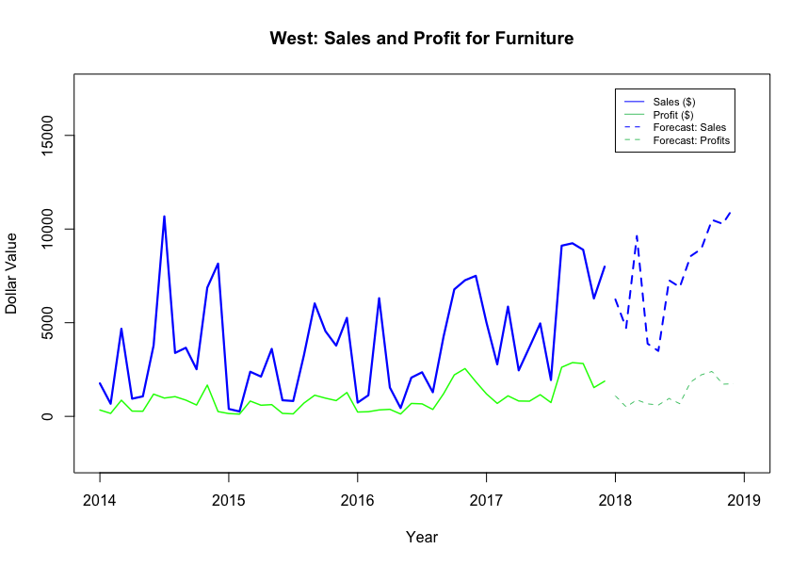
Office supplies: Sales and Profit Forecasts
Central
East
Forecasted Average Sales and Profits: Next 6 Months
 | Central | East | South | West
Sales | $ 3,637 | $ 5,265 | $ 2,235 | $ 5,871
Profits | - $ 77 | $ 778 | $ 537 | $ 785
Profit Margin | - 2% | 14% | 24% | 13%
South
West

Slide 12
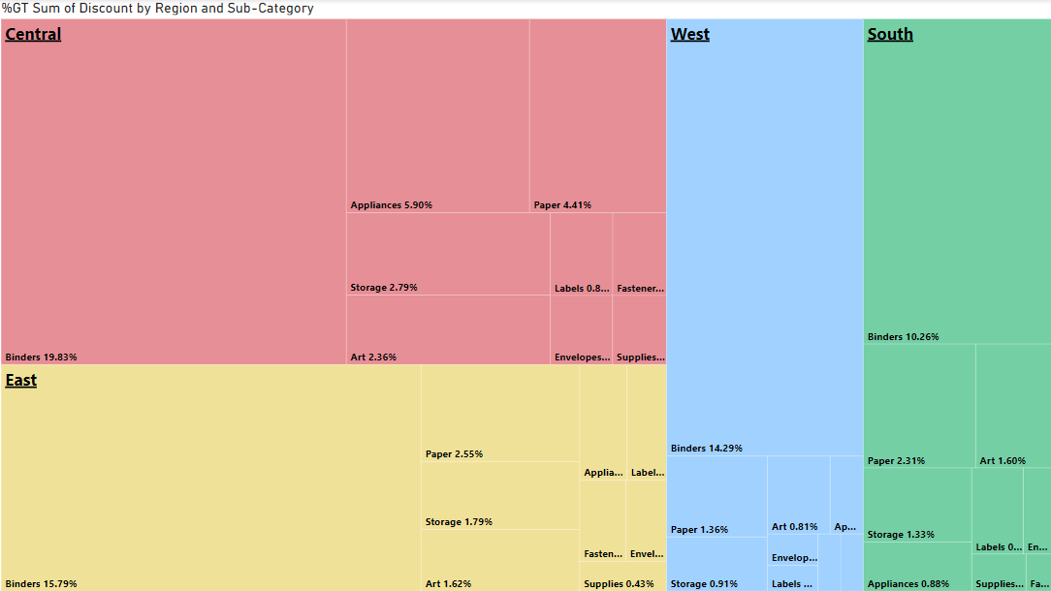
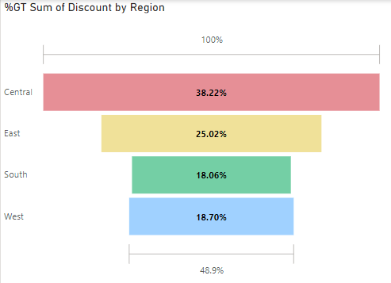
INFLUENTIAL FACTORS - DISCOUNTS
Central region has the highest discounts, possibly explaining the lower profit margin
Binders in Central region accounted to 19.83% of the total discounts across regions and sub categories

Slide 13
Recommendations
Furniture
Optimize logistics network to cut costs and improve profit margin
Improve inventory management system to avoid offering excessive discounts
Region Category | East | West | South | Central
Furniture | 6% | 4% | 4% | -2%
Technology | 95% | 12% | 20% | 30%
Office Supplies | 14% | 13% | 24% | -2%
6% | 4% | 4% | -2%
95% | 12% | 20% | 30%
14% | 13% | 24% | -2%
Technology
Focus on promoting copier sales as it has highest growth potential
* Based on the forecasts for next 6 months
Office Supplies
Reduce the considerable discounts in Central region
Notes:
Average Profit Margin from copier is 35% in comparison to the overall 19%

Slide 14



KEY TAKEAWAYS
To generate more accurate forecasts, Look to
Improve DATA QUALITY
Remove inconsistencies
Improve data frequency
Include Exogenous variables
Seasonal trends
Economic indicators
Weather Patterns
Incorporate Advanced forecasting methods
Machine learning
Deep learning
Notes:
Limited accuracy: A forecast that relies on a limited set of factors may be less robust to changes in the environment or unforeseen events. This can lead to unexpected results and a lack of confidence in the forecast.
QUALITY OF THE DATA: Accurate forecasts require high-quality data that is representative of the situation being analyzed. This may require gathering data from a range of sources, verifying the accuracy of the data, and addressing any missing or incomplete data. – Dates (Resulting to aggregation)
Lack of exogenous variables: Since we used ARIMA models to generate the forecast, the model do not take into account any external variables that may affect the series. This can limit the model's ability to capture complex relationships in the data.
Incorporating other data analysis methods: such as Machine learning and Exploratory data analysis
Exploratory data analysis: Exploratory data analysis (EDA) is used to summarize the main features of the data, identify patterns, and detect outliers. EDA can help to identify potential issues with the data, such as missing or incomplete data, and help to determine which variables may be relevant for modeling.
Machine learning: Machine learning algorithms can be used to build predictive models based on the data, including time series data. Common machine learning algorithms for time series analysis include recurrent neural networks, decision trees, and support vector machines.

Slide 15

Thank you!

Slide 16
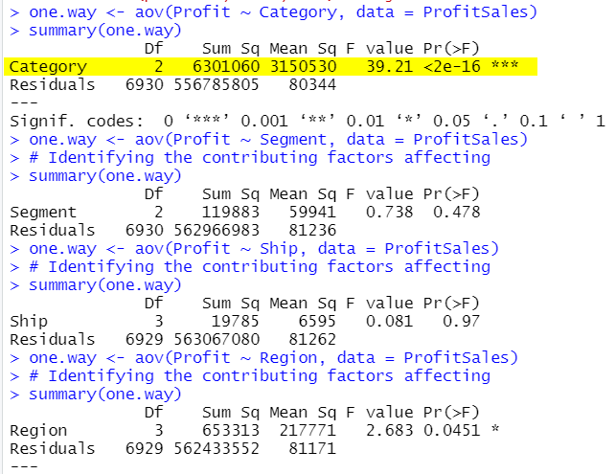

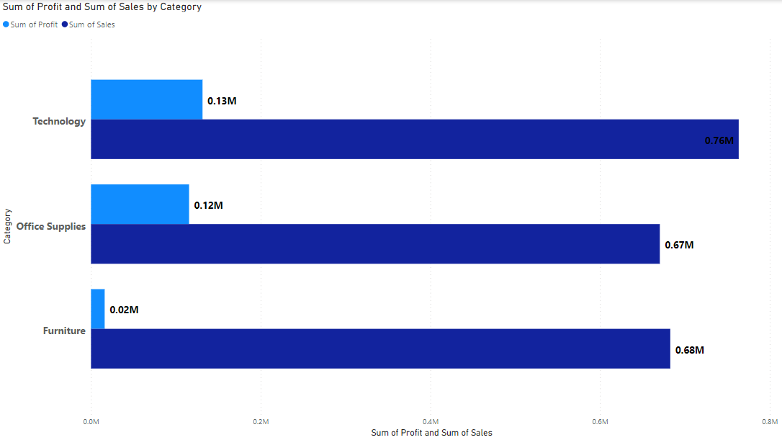
BUSINESS PROBLEM
BUSINESS PROBLEM
PROFIT forecasting for PRODUCT CATEGORIES ACROSS REGIONS
OBJECTIVE: Prioritize future investments for the company by forecasting profits next 6 months across different regions and product categories
ANOVA test was performed to check significance of variables for Category, Segment, Shipment and Region.
At a confidence interval of 95%, Category and Region can be claimed to be a statistically significant variable impacting Profit.

Slide 17
Business problem and methodology
Objective: Enable business to increase market share by forecasting sales and profits for the next 6 months across product categories and regions.
Exploratory Analysis
Create Data Plan
Aggregate data at month level and filter for non-returnable orders
Pick Forecasting Technique
Evaluate models and select the one with highest accuracy
Predict The Data
Forecasted Sales across regions and categories
Recommendations And Next Steps
Descriptive analysis to identify distribution of sales and profit across regions and categories
Call out risky and profit- making regions and categories to focus
METHODOLOGY

Slide 18
Business problem and methodology
OBJECTIVE: Enable business to increase market share by forecasting sales and profits for the next 6 months across product categories and regions.
Exploratory Analysis
Create Data Plan
Pick Forecasting Technique
Predict The Data
Recommendations And Next Steps
Descriptive analysis to identify profitable regions, products
Aggregate data at month level and filter for non-returnable orders
ARIMA
Smoothening
Holt Winter
Selected the model with least error
Use profit margin as a metric to select the market for future investments

Slide 19
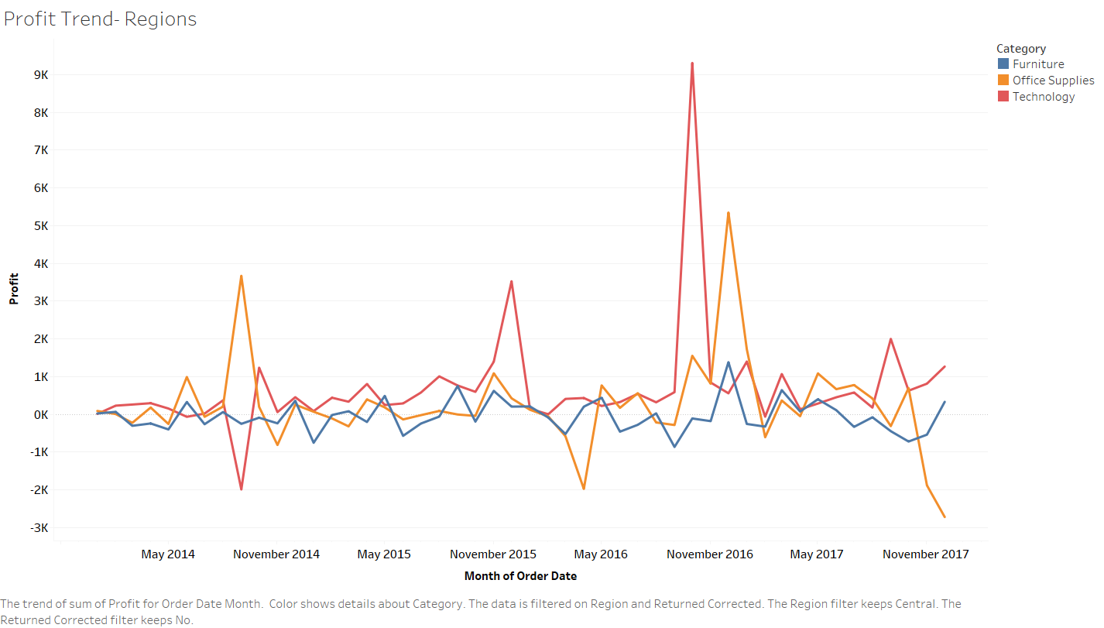
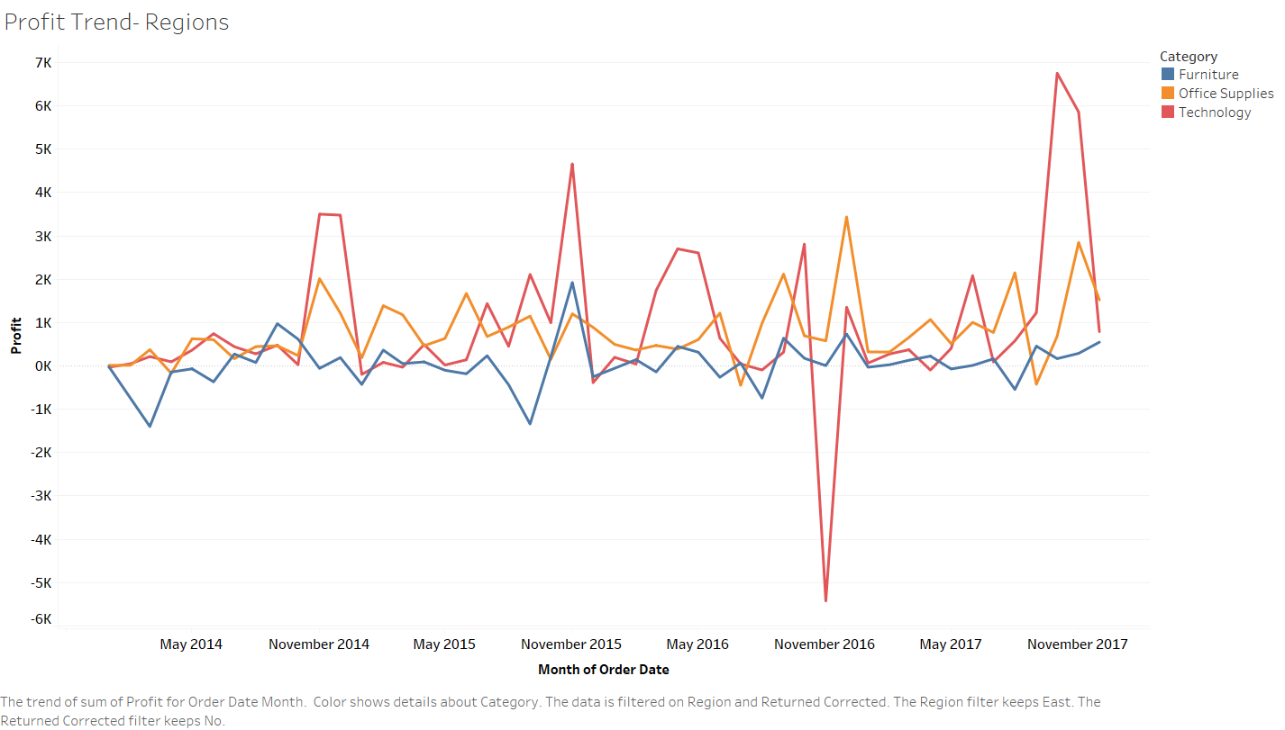
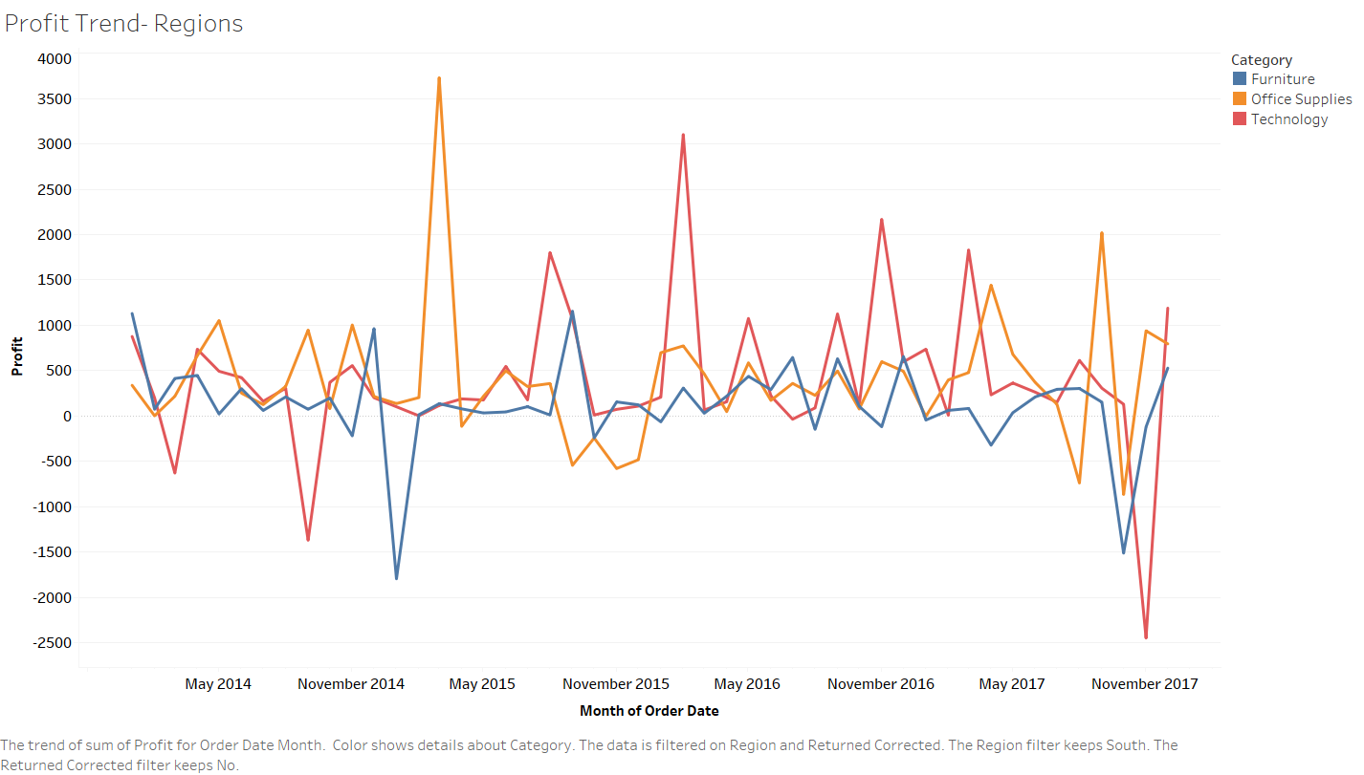
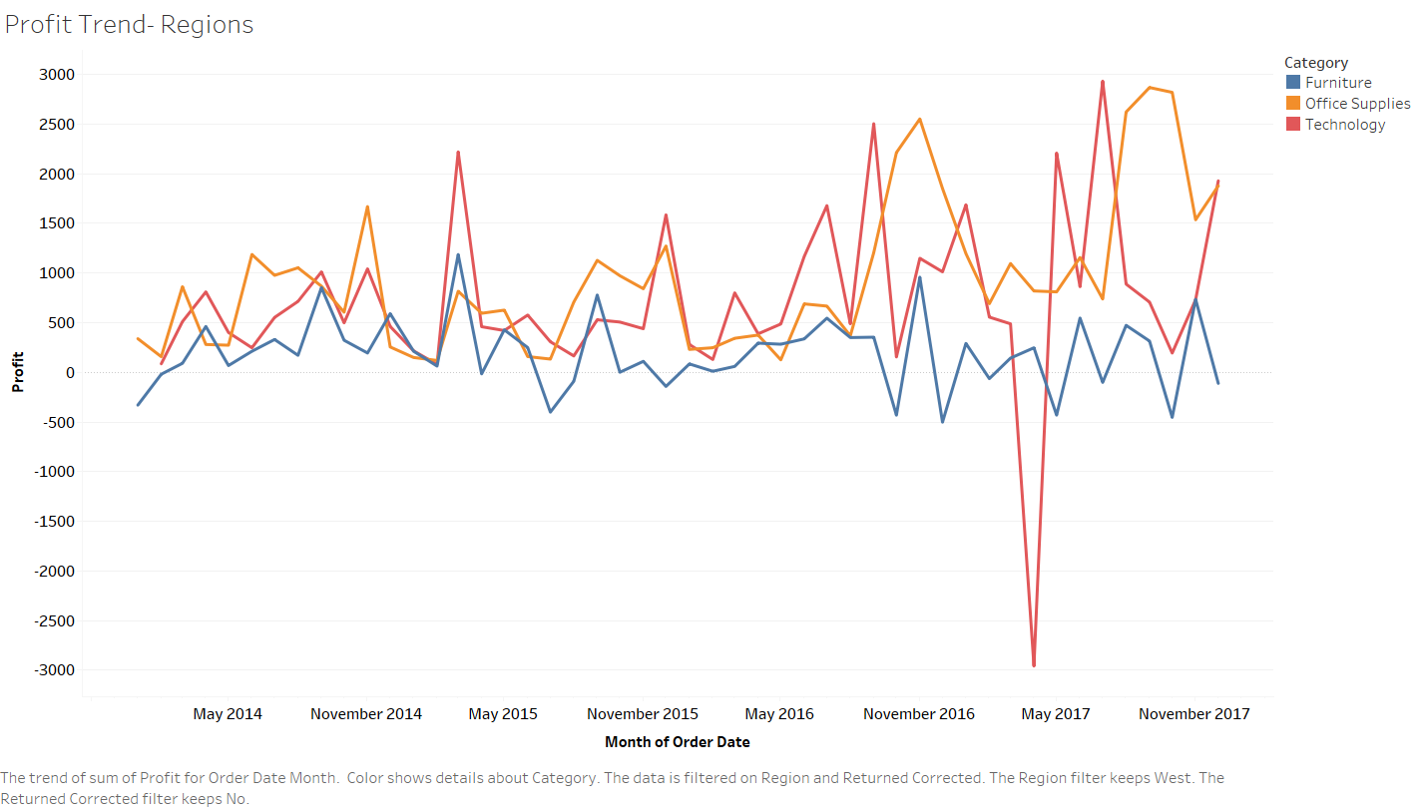
TRENDS OVER TIME
Central Region
East Region
South Region
West Region

Slide 20
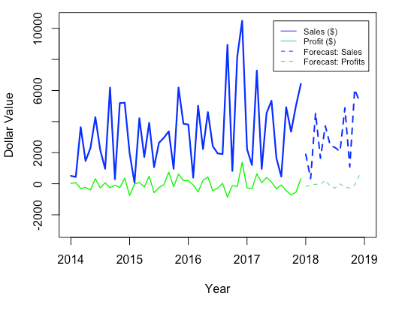
Furniture Sales & Profit Forecast :
WESTERN Region
Central
South
East

Slide 21
KEY TAKEAWAYS
To generate a more accurate forecast
QUALITY OF THE DATA
Exogenous variables
Incorporating other data analysis methods:
Machine learning
DEEP LEARNING
Notes:
Limited accuracy: A forecast that relies on a limited set of factors may be less robust to changes in the environment or unforeseen events. This can lead to unexpected results and a lack of confidence in the forecast.
QUALITY OF THE DATA: Accurate forecasts require high-quality data that is representative of the situation being analyzed. This may require gathering data from a range of sources, verifying the accuracy of the data, and addressing any missing or incomplete data.
Lack of exogenous variables: Since we used ARIMA models to generate the forecast, the model do not take into account any external variables that may affect the series. This can limit the model's ability to capture complex relationships in the data.
Incorporating other data analysis methods: such as Machine learning and Exploratory data analysis
Exploratory data analysis: Exploratory data analysis (EDA) is used to summarize the main features of the data, identify patterns, and detect outliers. EDA can help to identify potential issues with the data, such as missing or incomplete data, and help to determine which variables may be relevant for modeling.
Machine learning: Machine learning algorithms can be used to build predictive models based on the data, including time series data. Common machine learning algorithms for time series analysis include recurrent neural networks, decision trees, and support vector machines.

Slide 22
West
Technology Sales & Profit Forecast :
EASTERN Region
Central
South

Slide 23
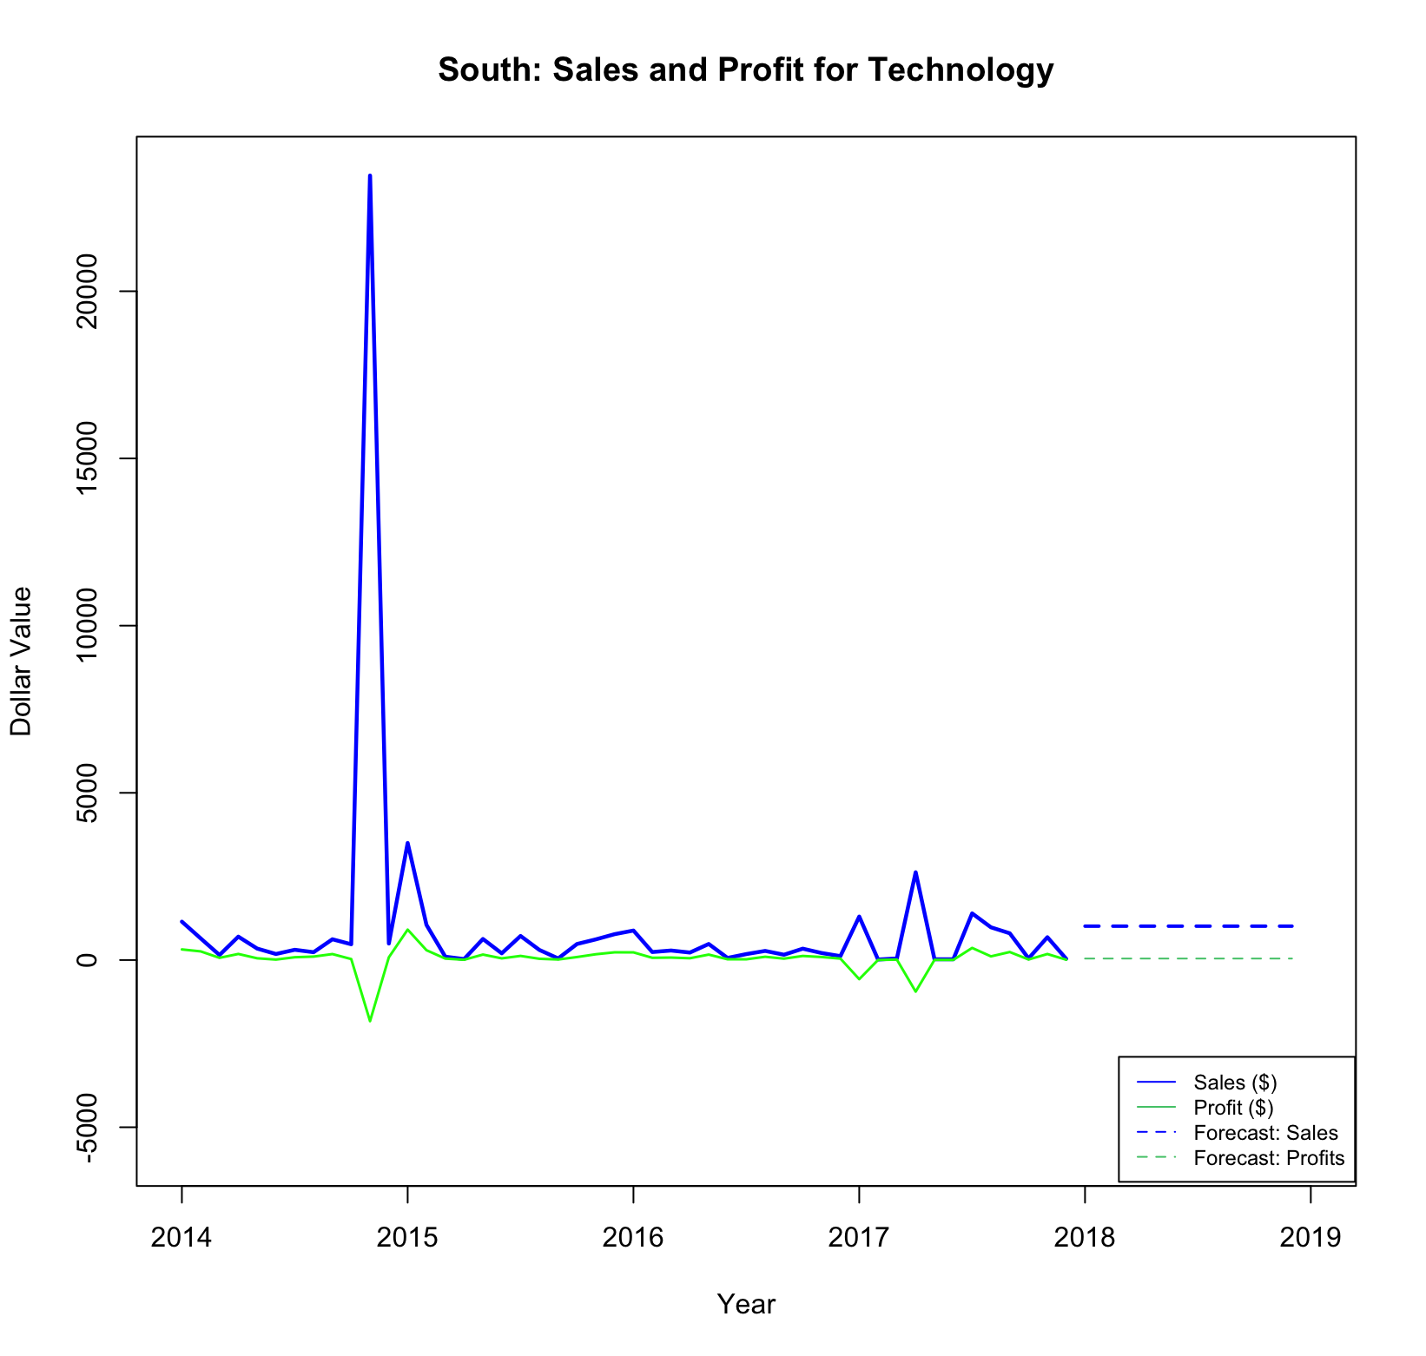
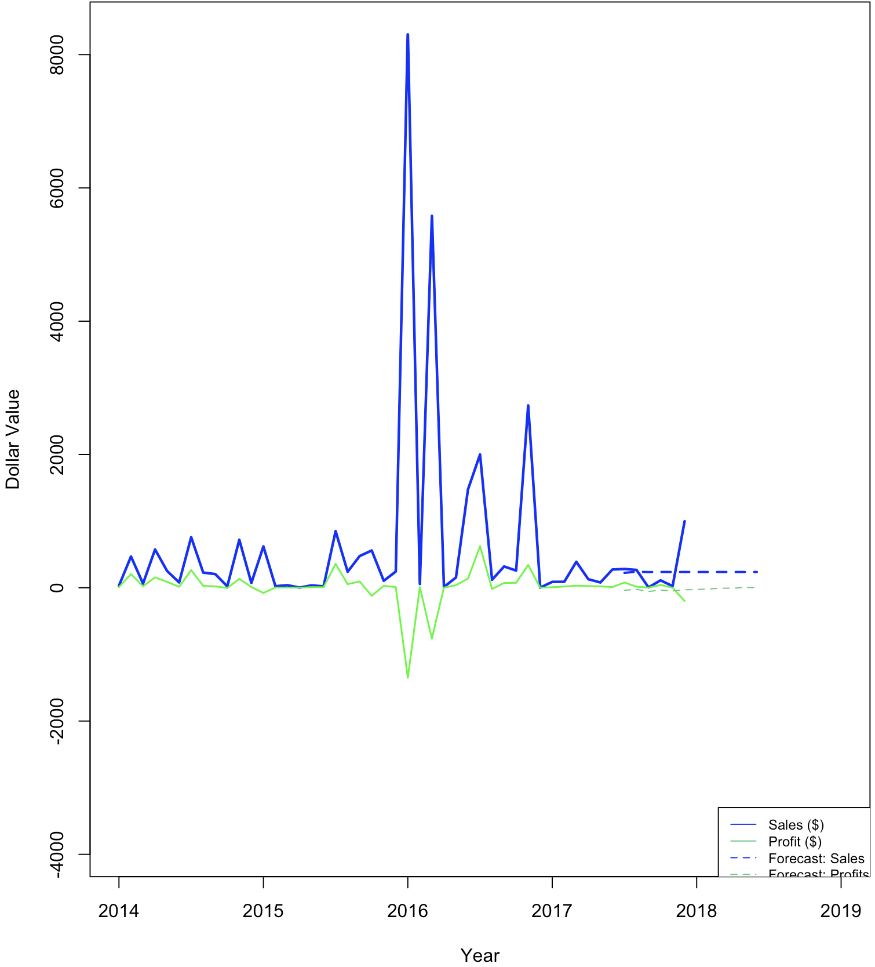
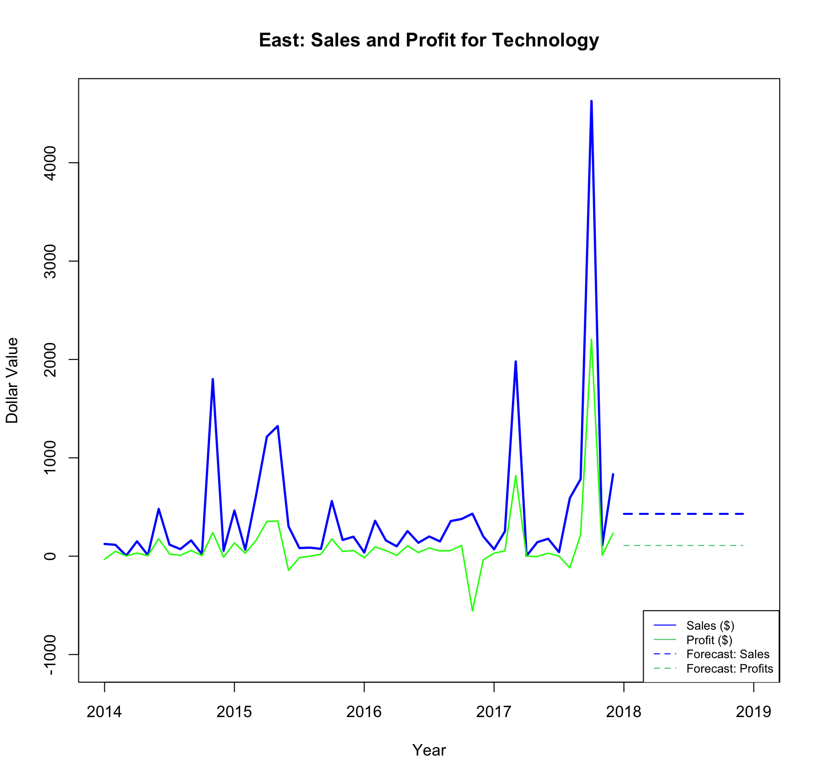
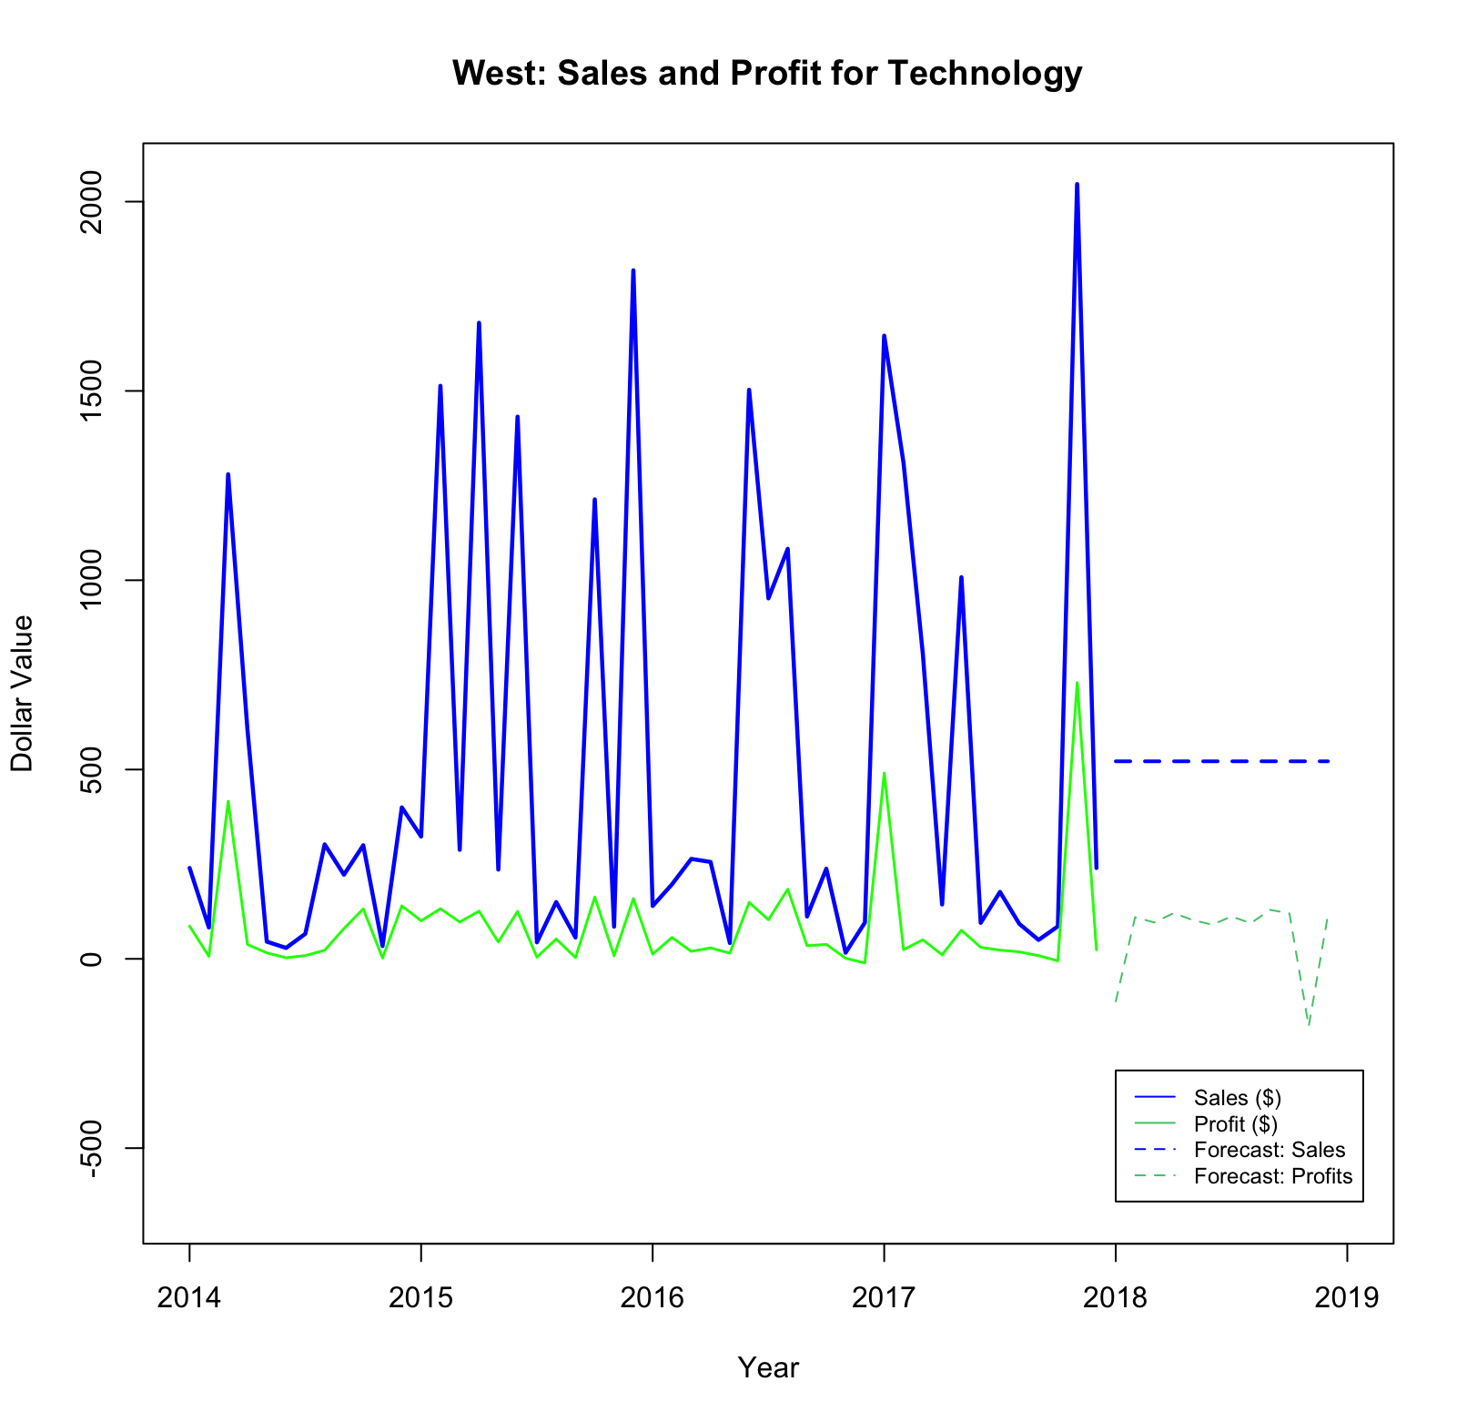
South
OFFICE SUPPLIES Sales & Profit Forecast :
Central Region
East
West

Slide 24
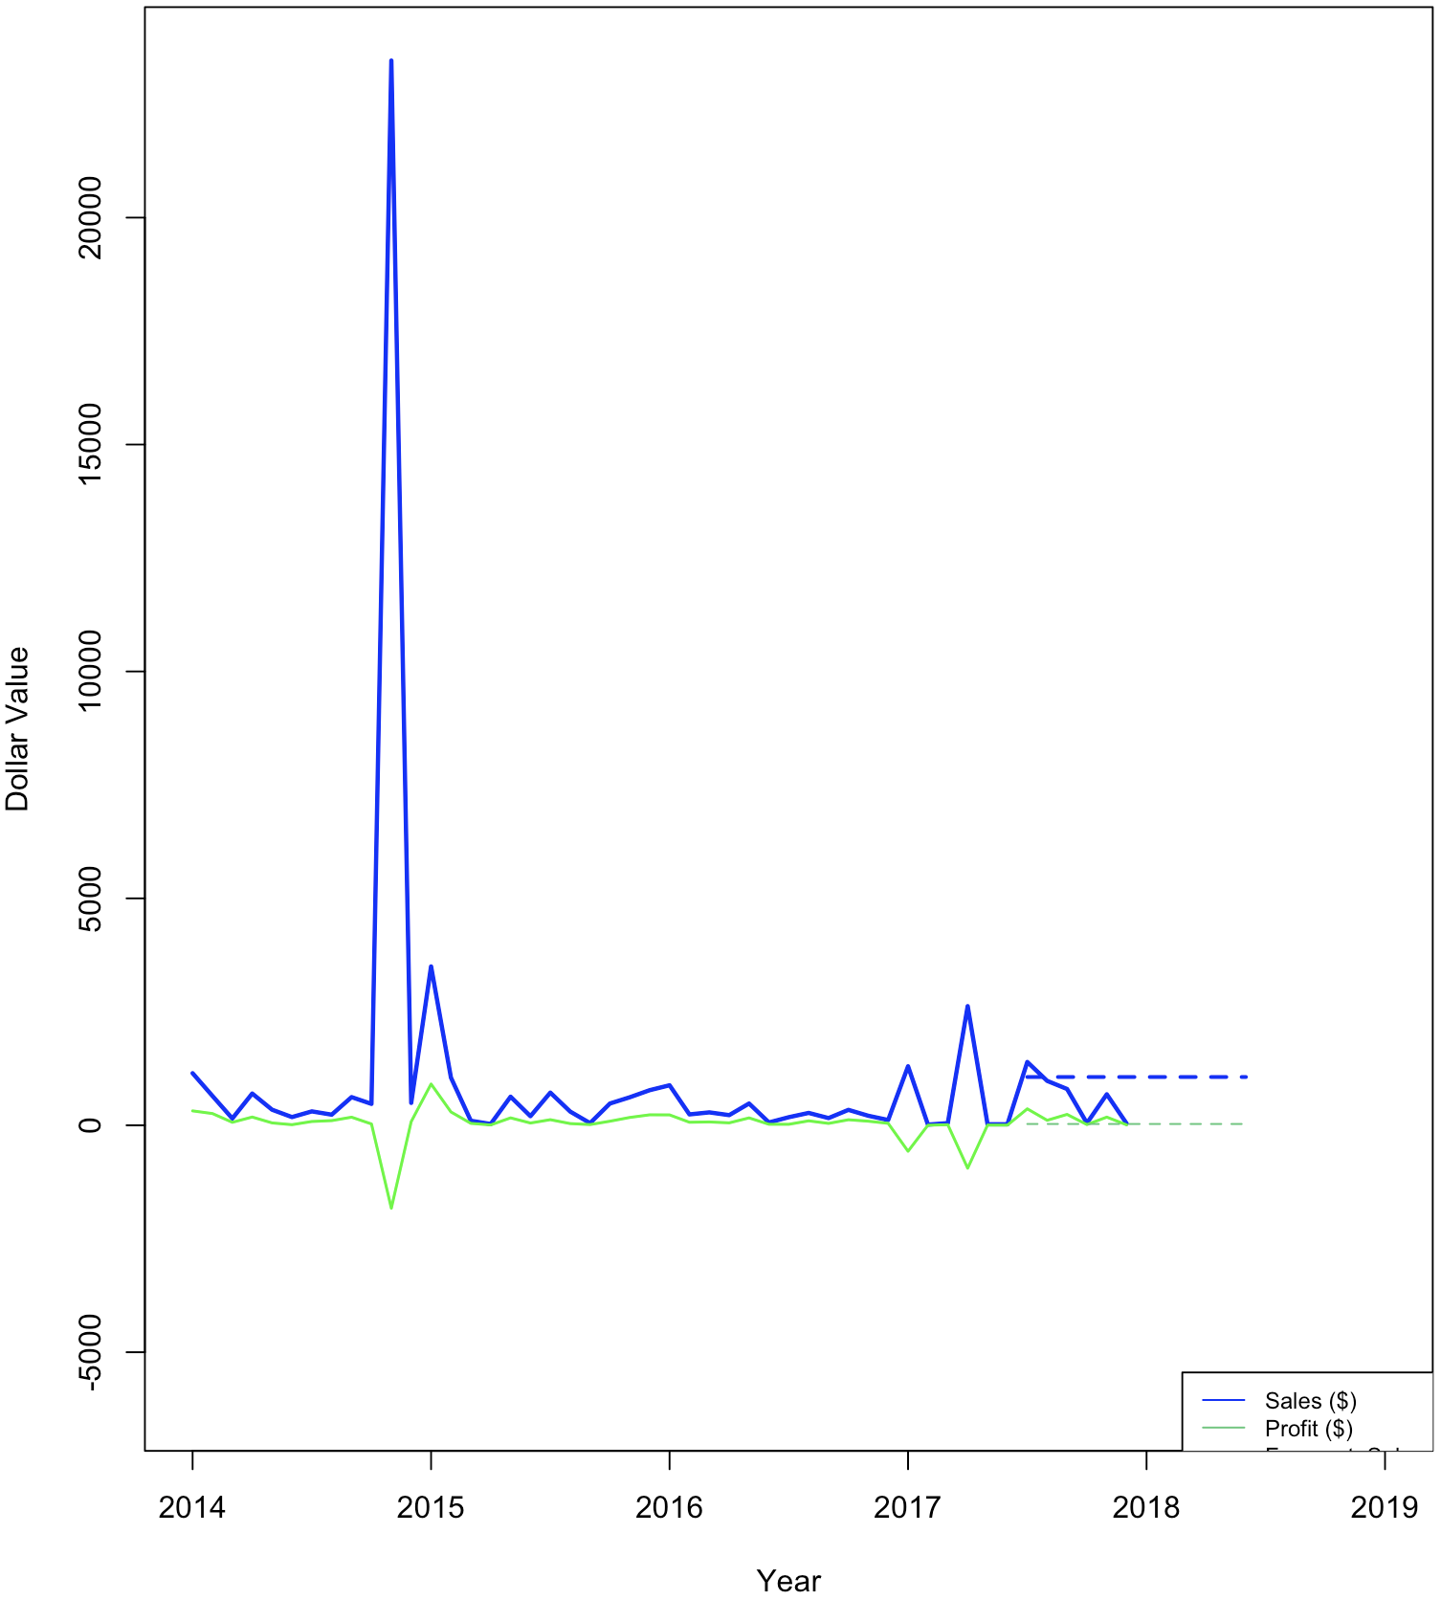
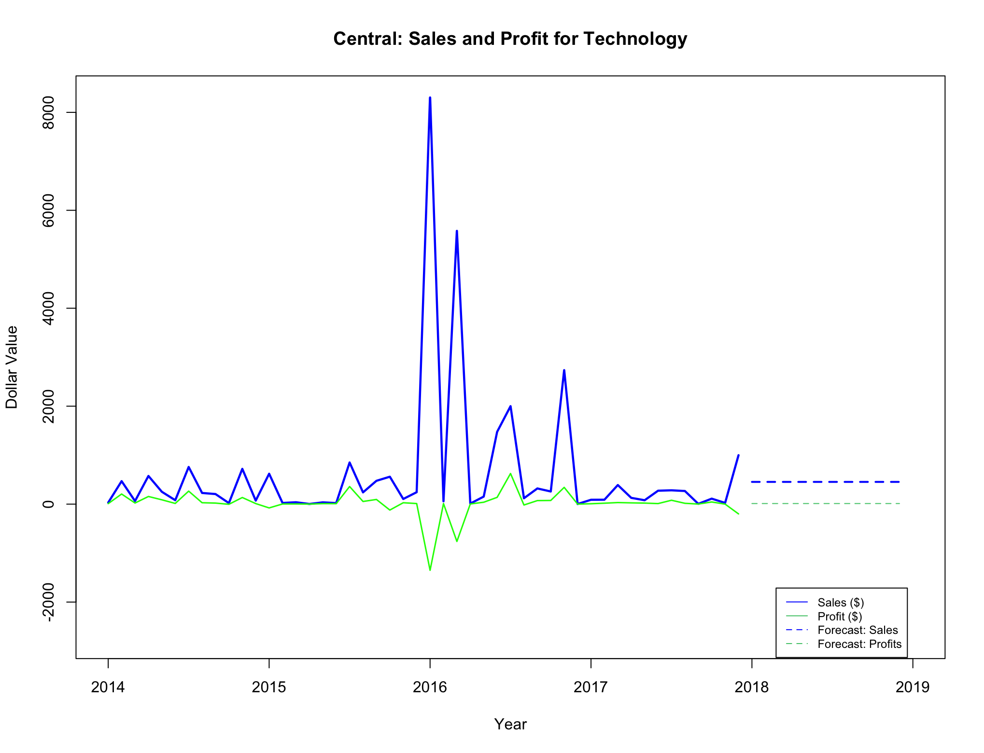
OFFICE SUPPLIES Sales & Profit Forecast :
SOUTHERN Region
East
West
Central

Slide 25
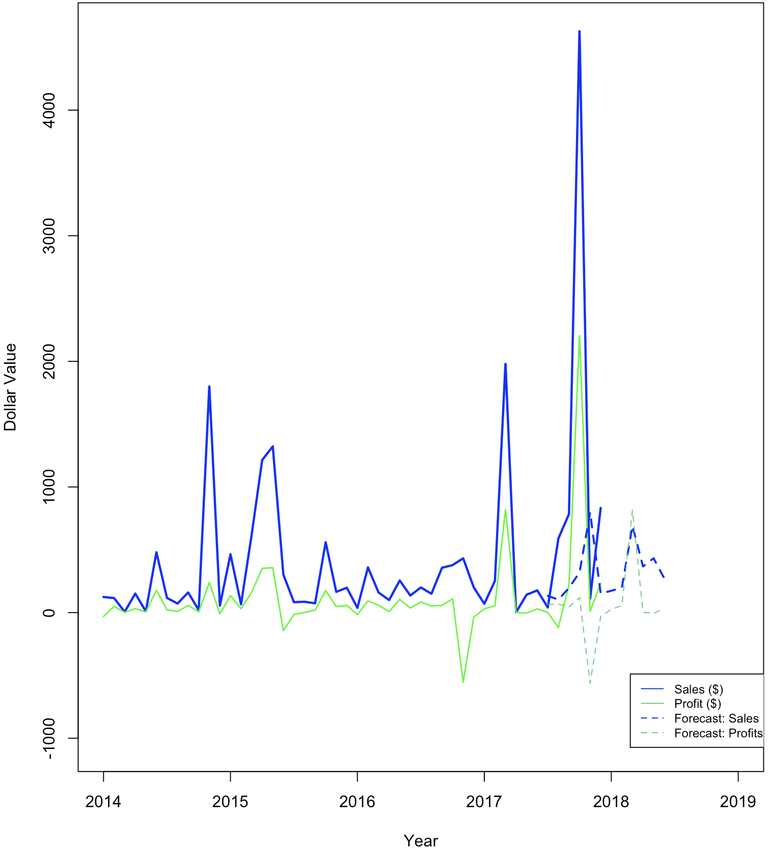
West
OFFICE SUPPLIES Sales & Profit Forecast :
EASTERN Region
Central
South

Slide 26
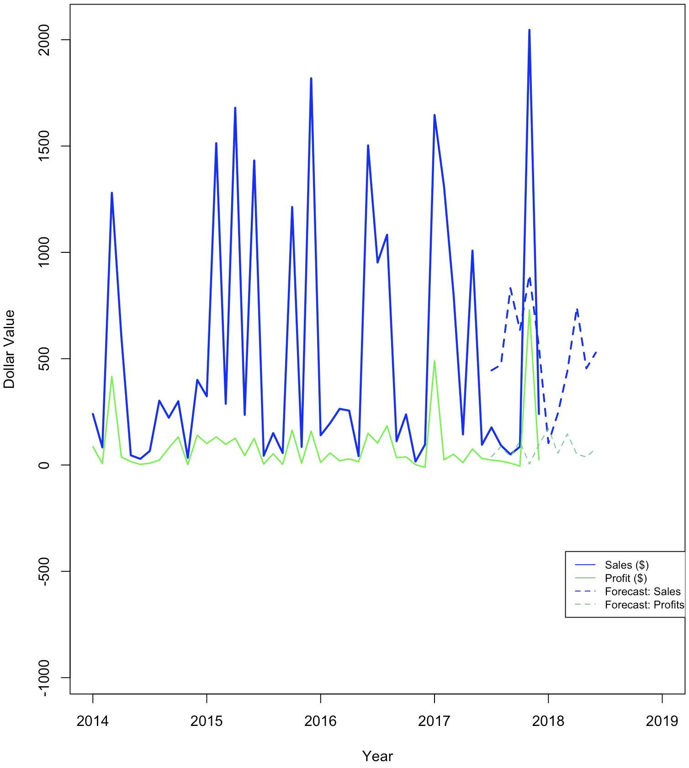
OFFICE SUPPLIES Sales & Profit Forecast :
WESTERN Region
Central
South
East

